Slide 1
Shaping the skills of our future workforce
Sharon Robertson CEO Innovation & Business Skills Australia (IBSA)
National Centre for Vocational Education Research Conference: No Frills Thursday 11th July 2019

Slide 2
The student journey:
skilling for life.
skilling across one’s life.

Slide 3
Around 70% of Australia’s young people enter the current labour market with skills that may soon be redundant.
Foundation for Young Australians, Investing in Young Australians, 2019.

Slide 4
The skills we need are not just technical.

Slide 5
The average Australian worker will likely change jobs 2.4 times over the next two decades.
AlphaBeta for Google Australia, Future Skills, 2019.

Slide 6
Between 2006-2016, workers over the age of 65 increased from 8% to 13% of the workforce.
Australian Institute of Health & Welfare, Older Australians at a glance, 2018.

Slide 7
The national skills deficit is set to grow.

Slide 8
Meet Michael.
Manages a manufacturing plant in Victoria.
His industry, business and workforce are currently impacted by
cheaper foreign product
process technology and automation
And things keep changing…

Slide 9
Evolve staff to grow with the changes of industry and the workforce.
Incorporate new tech in your business that can evolve staff skills - supported by relevant learning.
Develop flexible training programs to progress staff skills.
Connect learning with career progression opportunities to suit process changes.

Slide 10
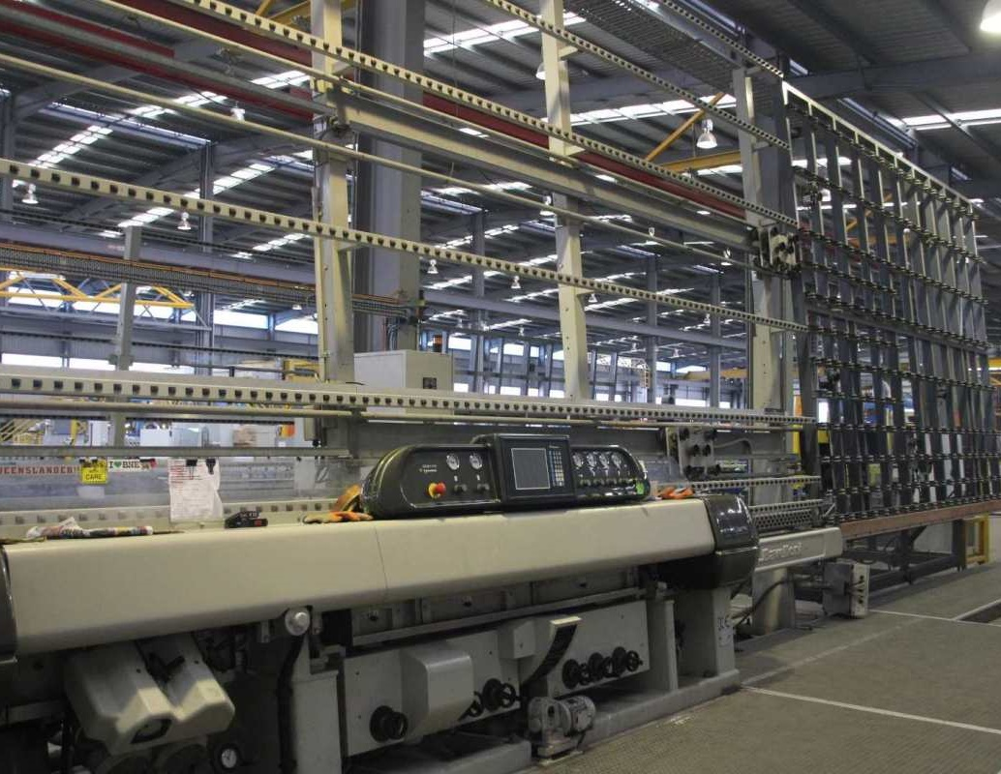
“G.James has a strong focus on investing in its people and ensuring they have the right skills for the work they need to do. People are always going to be vital to the effective running of our business, regardless of increases in automation.”
Rachel Driessen, Director, G.James Glass & Aluminium

Slide 11
Australians will spend 33% more time on education and training across their lifetime by 2040.
AlphaBeta for Google Australia, Future Skills, 2019.

Slide 12
Australians will undertake an additional 3 hours per week on education and training.
AlphaBeta for Google Australia, Future Skills, 2019.

Slide 13
In OECD countries, more than 20% of jobs are created or destroyed on average each and every year.
OECD, Employment Outlook 2009, 2009.

Slide 14
Joanne needs to feel valued.
Same hospitality employer for 3 years.
The business is changing around her.
Many other staff are taking on new responsibilities.
But the pathways just don’t seem clear to Joanne.

Slide 15
Grow staff skills with your business.
Develop accessible programs to enable efficient and ongoing reskilling.
Clearly link learning with industry to provide responsive, real-time, relevant and timely experience.
Develop flexible programs allowing learners to meet varying occupational requirements.

Slide 16
“Our members are always talking about the skills needed by their employees. …We have recently developed a menu-based training model to train with Australian Training Products that is designed to develop job-ready employees more effectively than the traditional linear approach to hospitality training.”
Wes Lambert, CEO, Restaurant & Catering Association

Slide 17
IBSA bridges the skills gap between industry and the learner to shape Australian Industries.
Vision
Shaping workforce skills for the future

Slide 18
What we do:
Understand industry trends and future workforce needs through consultation and research.
Convert industry skills needs into national occupational standards.
Create engaging education and training solutions.

Slide 19
A not-for-profit with three main business areas.
1
2
3
IBSA Manufacturing
Skills Service Organisation developing qualifications
Australian Training Products
Creating resources for RTOs and other organisations
IBSA
Academy
Professional development courses for training practitioners

